Slide 2
F T
THIS

Slide 3

<FIT THIS>
F T
THIS

Slide 4
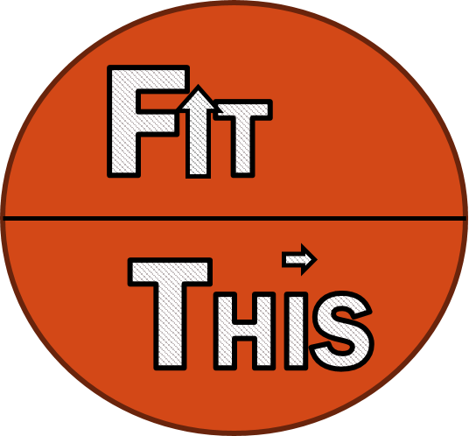
Fit This- Personal Fitness Tracker
User Name
<Last User>
Let’s Go!
Create New User
Help/Info
Exit

Slide 5
Fit This- Personal Fitness Tracker
User’s Fit Stats
Settings
Last login: 01/01/01
XXX
XXX
XXX
Current BMI
Current Weight
Total Calories Burnt
See All Stats
Update Food Log
Update Activity Log
Unlock/Enable Smart Suggestions?
Log Out

Slide 6
Fit This- Personal Fitness Tracker
User Set Up
We’ll need some info…
User Name
text
Age
text
Height
text
Current Weight
text
Male
Female
Unspecified
Current Activity Level
text
Select your theme?
text
Create!
Cancel

Slide 7
Fit This- Personal Fitness Tracker
User Settings
Delete User
Edit preferences & info
User Name
text
Age
text
Height
text
Current Weight
text
Male
Female
Unspecified
Current Activity Level
text
Select your theme?
text
Edit & Update
Cancel

Slide 8

Fit This- Personal Fitness Tracker
User’s Food Log
Date
Meal
Item
Amount
/ /
text
text
text
Add Entry
Edit Previous Entry
Done

Slide 9
Fit This- Personal Fitness Tracker
User’s Activity Log
You did WHAT?
When?
For how long?
text
/ /
mins
Add Entry
Edit Previous Entry
Done

Slide 10
Fit This- Personal Fitness Tracker
User’s Stats
Fit this user for XXX days
Current Weight (indicate if healthy weight based on BMI)
Pounds lost: (if any lost, else don’t show)
BMI:
BMR:
Total Calories Lost: XXX
This week: XXX
This month: XXX
This year: XXX
Total Activity Time:
Top Activity:
Export Stats?
Done

Slide 11
Fit This Flow/ Screens
Login/Startup Screen- For previous users… if user’s don’t exist yet, prompt creation.
User Home Page- Stats & such
Create new user
Current User Settings
Activity Tracker
Food Tracker
Detailed Stats

